Slide 1
Engineering Materials & Metallurgy (MEMEC02/MPMEC02)
UNIT 3:
Phase Equilibrium, Micro-structure and Failure Analysis

Slide 2
Contents (Unit 3)
Lec. No. | Details of the Topics to be covered
1 | Basic definitions and terminology, Hume-Ruthery conditions, Gibb’s Phase Rule
2 | Unary phase diagram
3 | Binary isomorphous phase diagram
4 | Binary eutectic phase diagram
5 | Iron-Carbon Phase Transformation
6 | Diffusion of Solids, Fick’s I and II law
7 | Micro-Structural Examination
8 | Failure Analysis

Slide 3
Key terms
Phase:
Homogeneous portion of a system that has uniform physical and chemical characteristics
Component:
Components are pure metals and/or compounds of which an alloy is composed.
System:
System may refer to a specific body of material under consideration (e.g., a ladle of molten steel). Or
it may relate to the series of possible alloys consisting of the same components, but without regard to alloy composition (e.g., the iron–carbon system).

Slide 4
Cont..
Solubility limit:
Maximum concentration of solute atoms that may dissolve in the solvent to form a solid solution is called a solubility limit.
Solid solution:
consists of atoms of at least two different types
solute atoms occupy either substitutional or interstitial positions in the solvent lattice
crystal structure of the solvent is maintained.
Difference between Solution & Mixture:
A solution (liquid or solid) is phase with more than one component while mixture is multiphase.

Slide 5
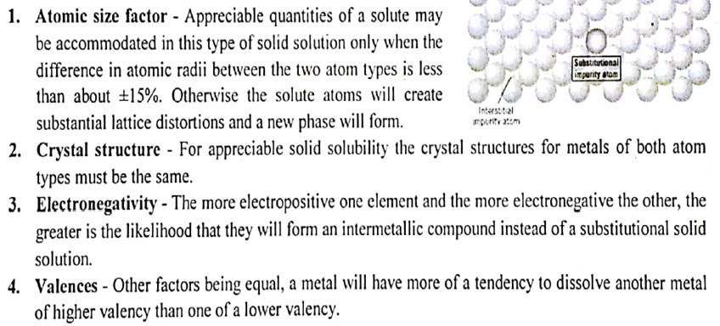
Hume-Ruthery conditions
To determine the degree to which solute dissolves in the solvent

Slide 6
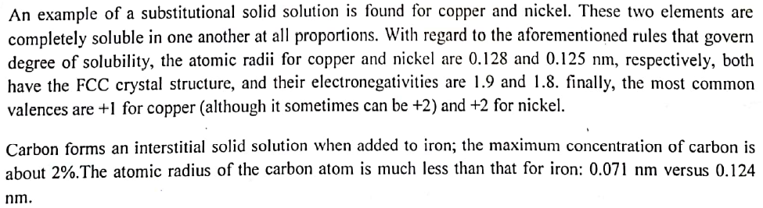
Cont..

Slide 7
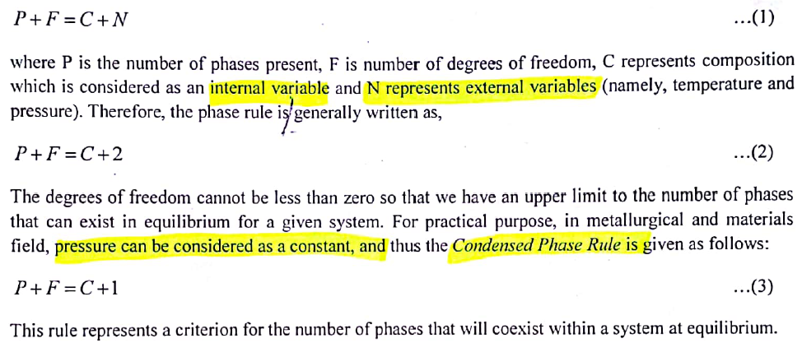
Gibb’s Phase Rule

Slide 8
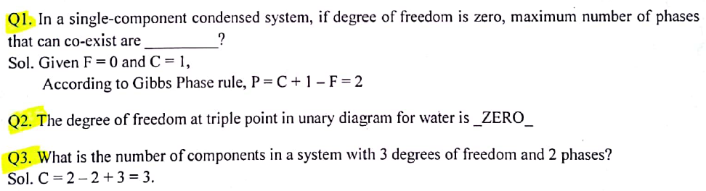
Cont..

Slide 9
Phase Diagram
Graphical representation showing different phases of a substance or a mixture of substances that coexist in thermodynamic equillibrium and undergo phase changes at different operating conditions such as temperature, pressure or volume
Provides a convenient way of repersenting which state of phase/phases is stable for a particular set of conditions.
Provides valuable information about melting, casting, crystallization and other phenomenon.

Slide 10
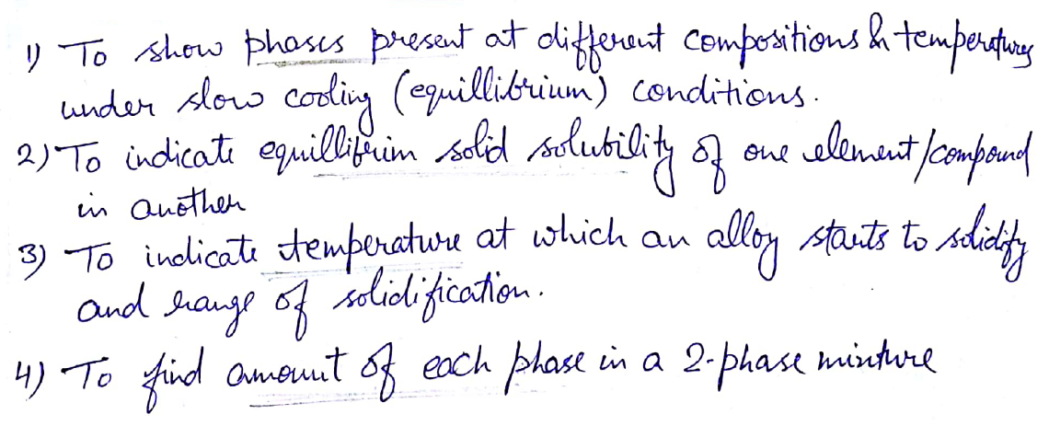
Uses of Phase Diagram

Slide 11
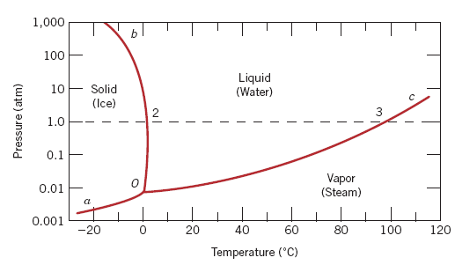
Unary Phase Diagram
Single component system
P-T diagram
Triple point of the water the point at which all the 3 phases coexist (i.e. F=0)
F=1
F=0
F=0

Slide 12
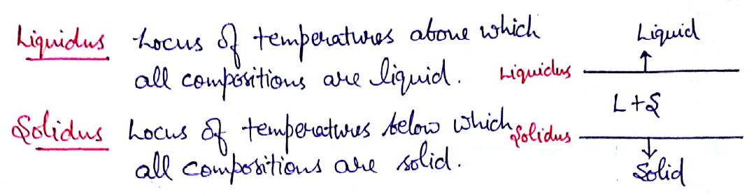
Cont..

Slide 13
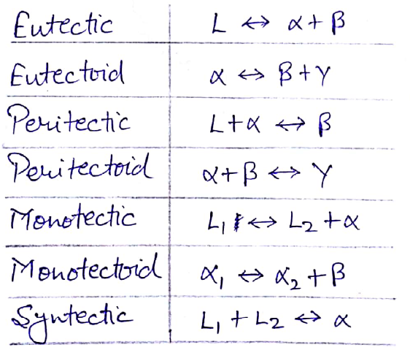
Invariant Reactions

Slide 14
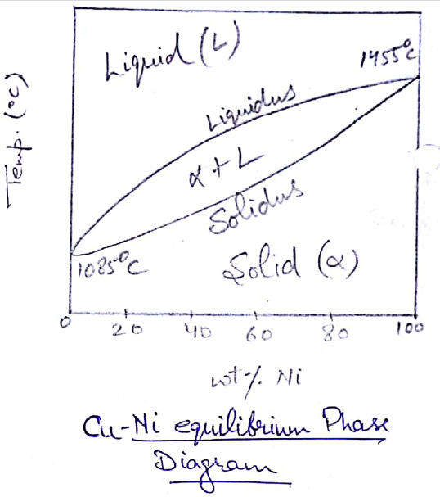
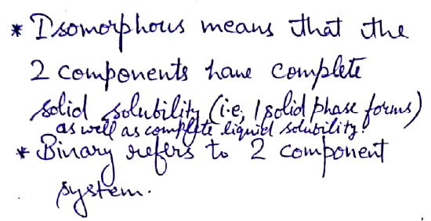
Binary Isomorphous Phase Diagram

Slide 15
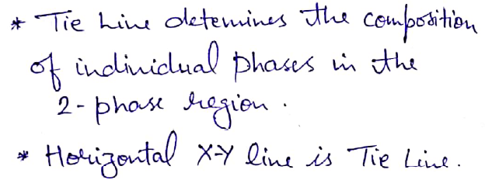
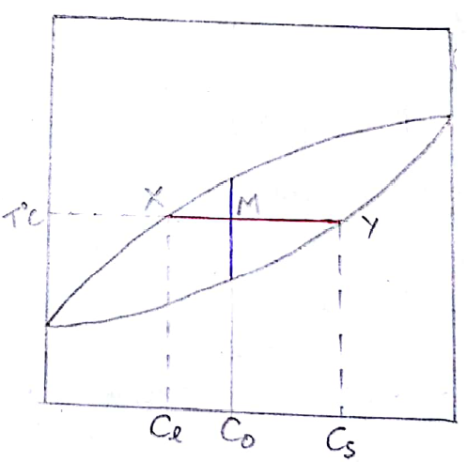
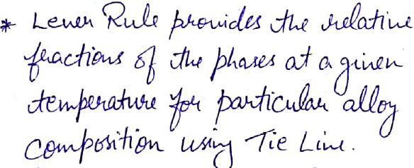
Tie Line and Lever Rule

Slide 16
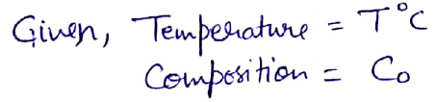
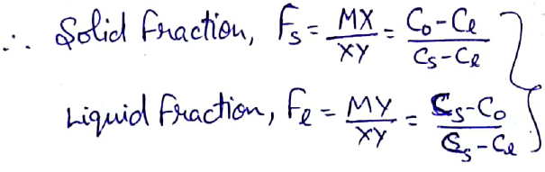
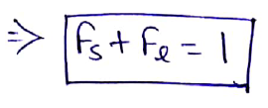
Cont..

Slide 17
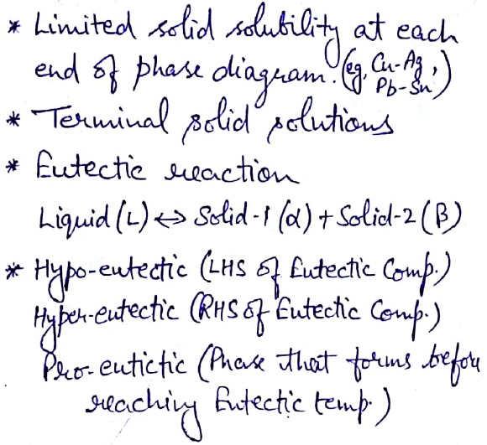
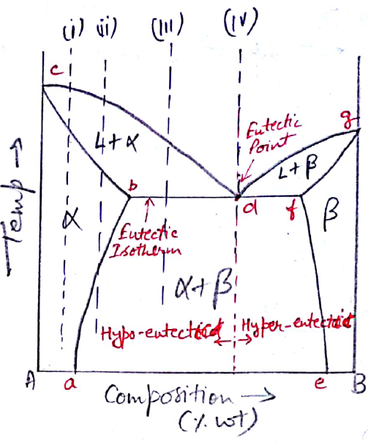
Binary Eutectic System

Slide 18
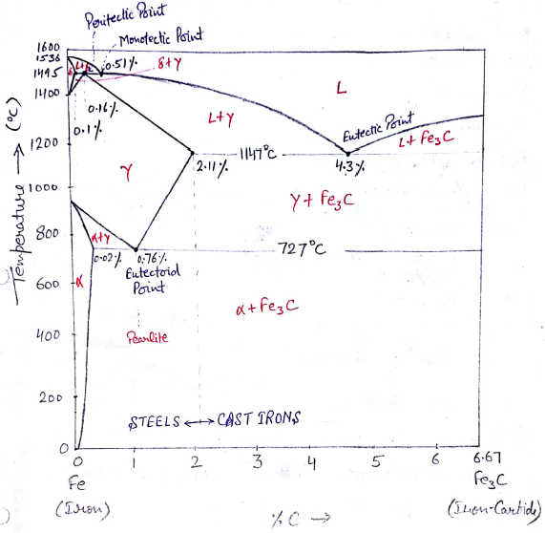
Iron-Carbon Phase Transformation

Slide 19
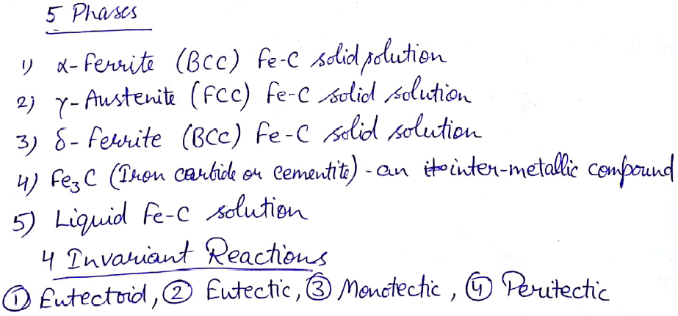
Cont..

Slide 20
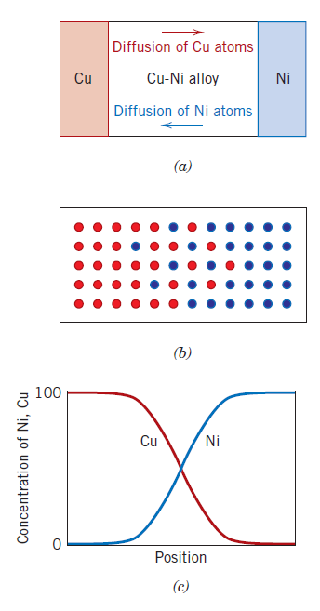
DIFFUSION
Phenomenon of material transport by atomic motion
Process, whereby atoms of one metal diffuse into another, is termed interdiffusion, or impurity diffusion
Diffusion also occurs for pure metals, but all atoms exchanging positions are of the same type; this is termed self-diffusion
Copper-Nickel diffusion couple

Slide 21
DIFFUSION MECHANISMS
For an atom to make move, two conditions must be met:
there must be an empty adjacent site,
the atom must have sufficient energy to break bonds with its neighbor atoms and then cause some lattice distortion during the displacement
At a specific temperature some small fraction of the total number of atoms is capable of diffusive motion, by virtue of the magnitudes of their vibrational energies. This fraction increases with rising temperature.
Types:
Vacancy Diffusion
Interstitial Diffusion

Slide 22
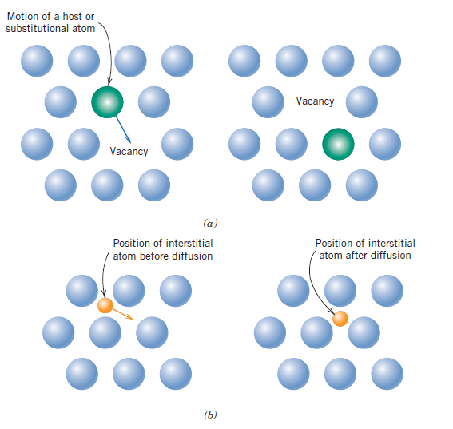
Cont..
(a) Vacancy diffusion, (b) Interstitial diffusion

Slide 23
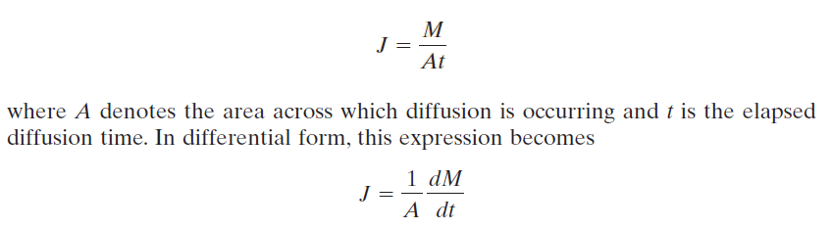
STEADY-STATE DIFFUSION
Diffusion flux (J) –
how fast diffusion occurs, or the rate of mass transfer
M diffusing through and perpendicular to a unit cross-sectional area of solid per unit of time
Steady-state diffusion is the diffusion of atoms of a gas through a plate of metal for which the concentrations (or pressures) of the diffusing species on both surfaces of the plate are held constant

Slide 24
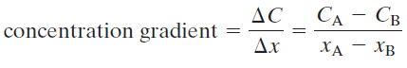
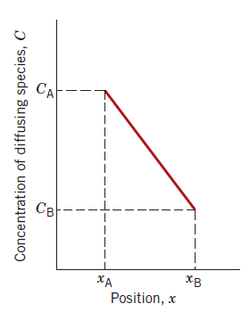
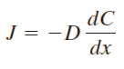
Cont..
Fick’s first law
diffusion flux for steady-state diffusion (in one direction)
D is the constant of proportionality called the diffusion coefficient
negative sign in this expression indicates that the direction of diffusion is down the concentration gradient, from a high to a low concentration

Slide 25
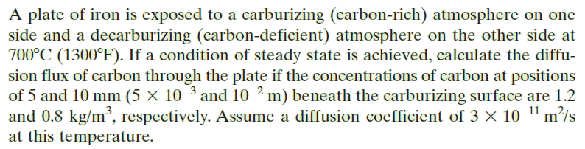
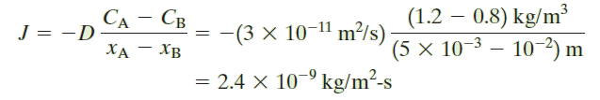
Problem
SOLUTION

Slide 26
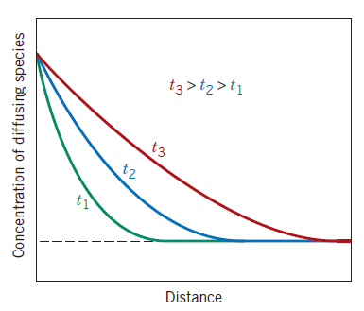
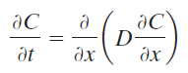
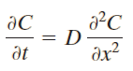
NONSTEADY-STATE DIFFUSION
Diffusion flux and the concentration gradient at some particular point in a solid vary with time, with a net accumulation or depletion of the diffusing species resulting
or
These expressions are known as Fick’s second law

Slide 27
Microstructural Examination

Slide 28
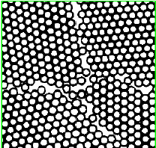
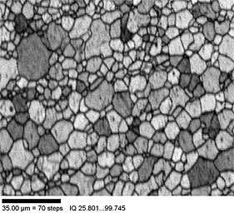
Introduction
Grain boundary
Microstructure:
It is the geometric arrangement of grains and the different phases present in a material.
Grain Boundaries:
It is the interface between two grains in a polycrystalline material where the crystal is disordered due to rapid change in crystallographic directions.
Figure showing the microstructure

Slide 29
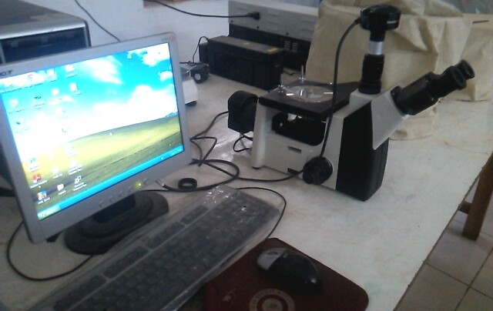
Optical Microstructure
Optical Microscope
Optical microscope with computer attached to obtain the microstructure

Slide 30
Micro-structural Analysis used for?
Quality Control: Analysis is used to determine whether the structural parameters are within specifications: a criteria for ACCEPTANCE or REJECTION of products
Failure Analysis: to determine the cause of failure. Failure occur due to several factors (incorrect material selection, improper processing treatment, poor quality control).Failure analysis provides information about the cause of failure
Research Studies: It is used to determine the microstructural changes that occur as a result of varying parameters such as composition, heat treatment or processing. The research studies develop the PROCESSING – STRUCTURE - PROPERTIES relationships.

Slide 31
Applications
Study and characterization of materials.
Ensure that the associations between properties and structure are properly understood.
Predict properties of materials.
Design alloys with new properties.
Check if the material has been correctly heat treated.

Slide 32

Safety Instructions
Optical Metallography involves the use of etchants (standard solutions containing a variety of chemicals such as strong acids and solvents) which can be very corrosive and poisonous.

Slide 33
Specimen Preparation
Specimen preparation is an important part of metallography (study of microstructure).
A specimen must be appropriately prepared to ensure correct observation and interpretation of the microstructure.
Specimen preparation requirements
Deformation-free specimen
Flat specimen
No thermal damage
No scratches

Slide 34
Specimen preparation consists of:
Sample Selection: The number, location orientation of the samples examined are important parameters in selection samples.
SECTIONING
MOUNTING
GRINDING
POLISHING
ETCHING

Slide 35
Sectioning
Sectioning is the first step in the overall process of sample preparation.
Sectioning of the test sample is performed carefully to avoid altering the structure of the material.
Abrasive cutting is the most common cutting method.
The cutting tool is made of Silicon carbide(Sic) and of diamond particles.
Use coolant fluid to avoid overheating of specimen and possible change in material structure.

Slide 36


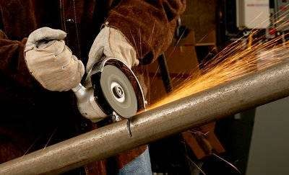
Sawing is perhaps the oldest method of sectioning that is still used today. It can be accomplished with a hand-held hacksaw, but
it can alter the microstructure.
Abrasive Wheel Sectioning: The most popular method of sectioning is with abrasive cut-off wheels. Wheels made of silicon carbide, aluminum oxide, and diamonds are used in the sectioning process. With this type of sectioning, the metallographer has more control over the conditions used.

Slide 37
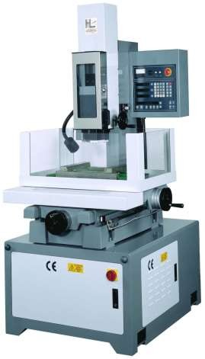
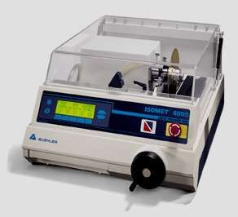
Machines used for sectioning:
Abrasive Cutter
EDM

Slide 38
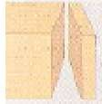
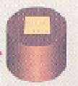
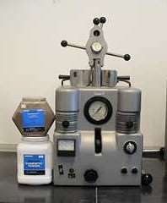
Mounting
Specimen
Mounting. Small samples can be difficult to hold safely during grinding and Polishing operations, and their shape may not be suitable for observation on a flat surface.
They are therefore mounted inside a polymer block or mount
mounting
Mounting Machine

Slide 39
Grinding
Grinding is done using rotating discs covered with silicon carbide paper and water.
There are a number of grades of paper, with 100, 240, 400, 800, 1000, 1200, grains of silicon carbide per square inch. 100 grade therefore represents the coarsest particles and this is the grade to begin the grinding operation. Always use light pressure applied at the centre of the sample.

Slide 40
Wash the sample in water and move to the next grade, orienting the scratches from the previous grade normal to the rotation direction. This makes it easy to see when the coarser scratches have all been removed.
After the final grinding operation on 1200 paper, wash the sample in water
followed by alcohol and dry
it before moving to the polishers.

Slide 41
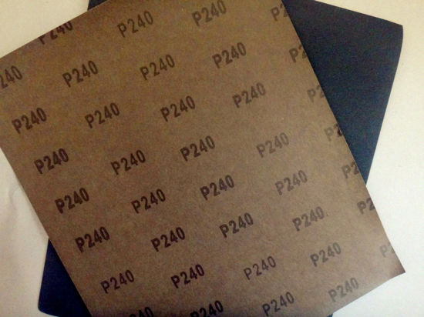
Emery Papers

Slide 42
Polishing
The polishers consist of rotating discs covered with soft cloth impregnated with a pre-prepared slurry of hard powdery alumina particles (Al2O3, the size ranges from 0.5 to 0.03 µm).
Begin with the coarse slurry and continue polishing until the grinding scratches have been removed. It is of vital importance that the sample is thoroughly cleaned using soapy water, followed by alcohol, and dried before moving onto the final stage. Any contamination of the final polishing disc will make it impossible to achieve a satisfactory polish.
Examining the specimen in the microscope after polishing should reveal mirror like surface.

Slide 43
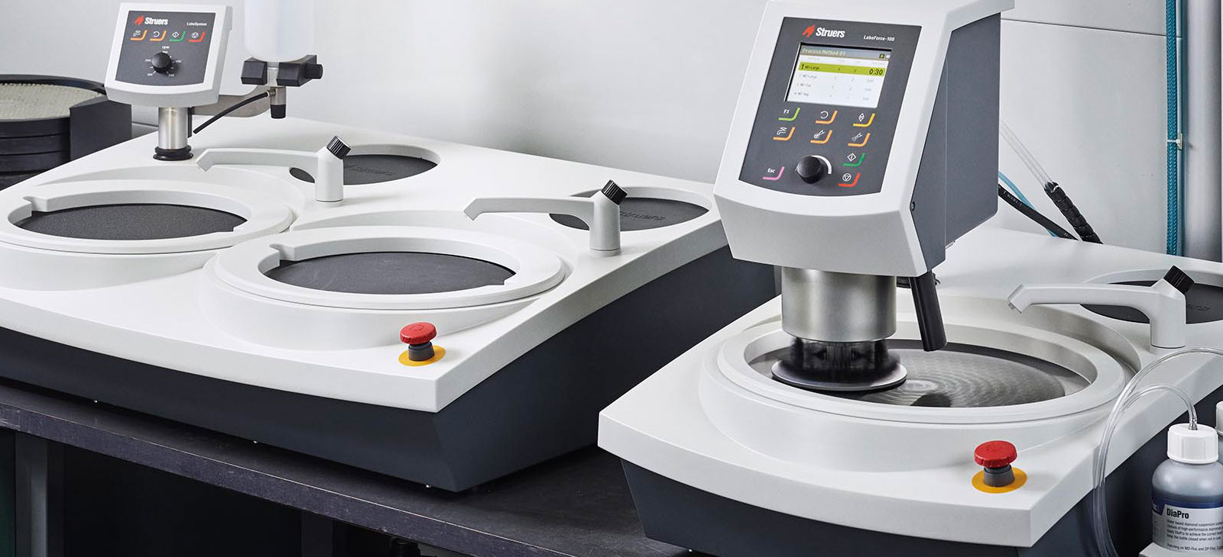
Machine for Grinding and Polishing
Figure showing machine used for grinding and polishing.

Slide 44
Etching
The purpose of etching is two-fold.
Grinding and polishing operations produce a highly deformed, thin layer on the surface which is removed chemically during etching.
Attacks the surface with preference for those sites with the highest energy, leading to surface relief which allows different crystal orientations, grain boundaries, precipitates, phases and defects to be distinguished in reflected light microscopy.

Slide 45
Etching
Etching should always be done in stages, beginning with light attack, an examination in the microscope and further etching only if required.
If you overetch a sample on the first step then the polishing procedure will have to be repeated.
The table below gives the etchants for alloys.
Sample Material | Etchant used
Al alloys | Keller’s (2 ml HF +3 ml HCL + 5 ml NO3+ 190 ml water)
Cu-Zn alloy (brass) | 10 ml HNO3+90 ml water
Steel and cast irons | Nital (2% HNO3 + 98% ethanol)

Slide 46
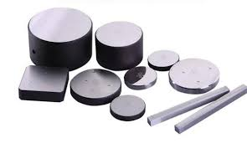
Samples prepared for Vickers Hardness test.

Slide 47
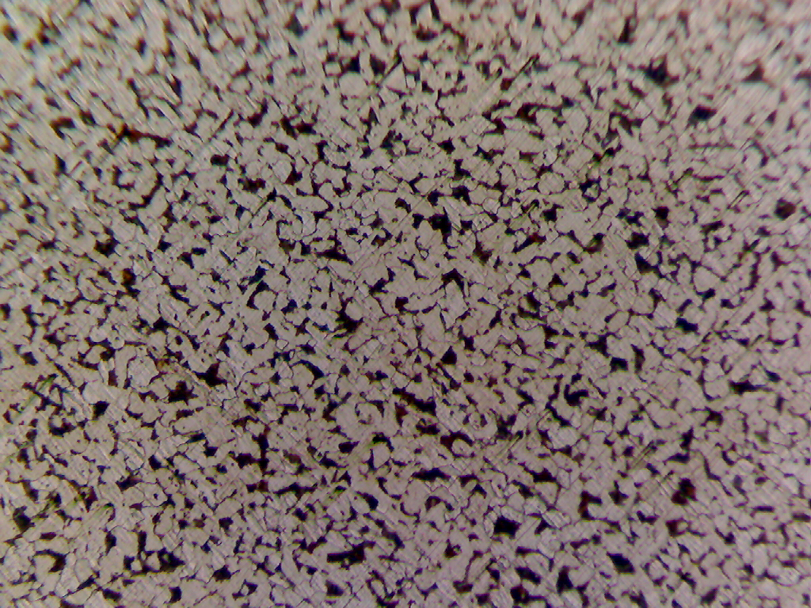
Microstructure of Mild steel base plate at 100× magnifications

Slide 48
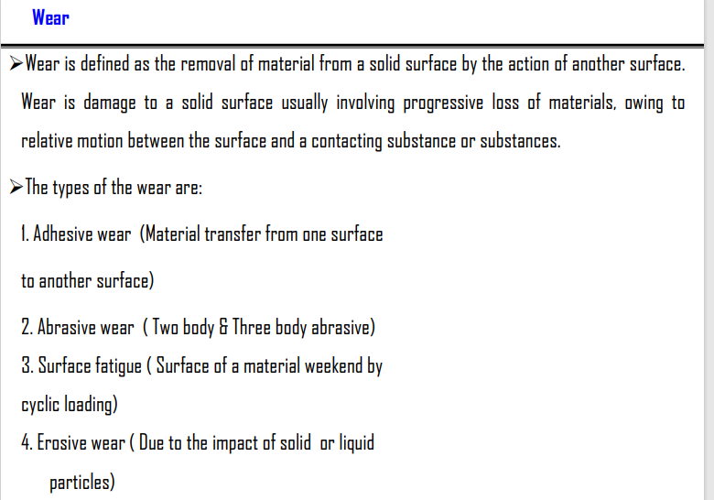

Slide 49

Corrosion
Corrosion is defined as the destructive and unintentional attack of a metal; it is electrochemical and ordinarily begins at the surface.
The problem of metallic corrosion is one of significant proportions; in economic terms, it has been estimated that approximately 5% of an industrialized nation’s income is spent on corrosion prevention and the maintenance or replacement of products lost or contaminated as a result of corrosion reactions.

Slide 50
The consequences of corrosion are all too common. Familiar examples include the rusting of automotive body panels and radiator and exhaust components.
Corrosion processes are occasionally used to advantage. For example, etching procedures, make use of the selective chemical reactivity of grain boundaries or various microstructural constituents.

Slide 51
Corrosion rate
The corrosion rate, or the rate of material removal as a consequence of the chemical action, is an important corrosion parameter. This may be expressed as the corrosion penetration rate (CPR), or the thickness loss of material per unit of time.
CPR = KW/pAt
Where W is the weight loss after exposure time t; p and A represent the density and exposed specimen area, respectively, and K is a constant, its magnitude depending on the system of units used.

Slide 52
Forms of Corrosion in Metals
Metallic corrosion is sometimes classified into eight different forms:
Uniform Attack
Uniform attack is a form of electrochemical corrosion that occurs with equivalent intensity over the entire exposed surface and often leaves behind a scale or deposit.
In a microscopic sense, the oxidation and reduction reactions occur randomly over the surface. Some familiar examples include general rusting of steel and iron and the tarnishing of silverware. This is probably the most common form of corrosion

Slide 53
Galvanic Corrosion
Galvanic corrosion occurs when two metals or alloys having different compositions are electrically coupled while exposed to an electrolyte.
This is the type of corrosion or dissolution. The less noble or more reactive metal in the particular environment will experience corrosion; the more inert metal, the cathode, will be protected from corrosion.
For example, steel screws corrode when in contact with brass in a marine environment; or if copper and steel tubing are joined in a domestic water heater, the steel will corrode in the vicinity of the junction.

Slide 54
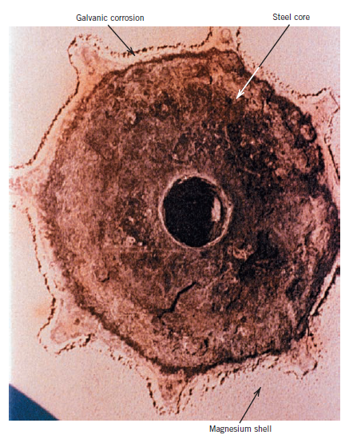
Galvanic Corrosion

Slide 55
Crevice Corrosion
Electrochemical corrosion may also occur as a consequence of concentration differences of ions or dissolved gases in the electrolyte solution, and between two regions of the same metal piece.
For such a concentration cell, corrosion occurs in the locale that has the lower concentration.
A good example of this type of corrosion occurs in crevices and recesses or under deposits of dirt or corrosion products where the solution becomes stagnant and there is localized depletion of dissolved oxygen. Corrosion preferentially occurring at these positions is called crevice corrosion

Slide 56
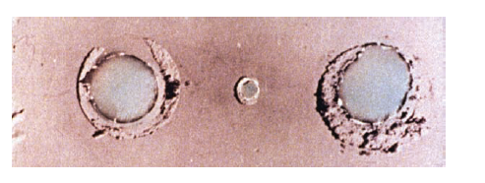
On this plate, which was immersed in seawater, crevice corrosion has occurred at the region that were covered by washers.

Slide 57
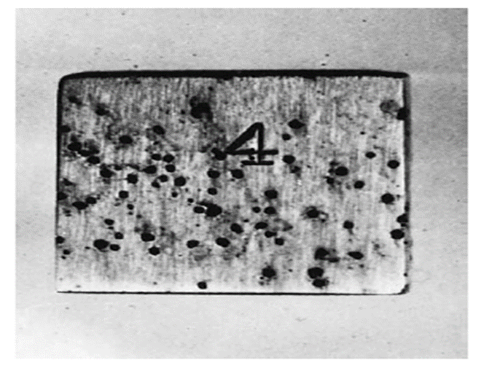
Pitting
Pitting is another form of very localized corrosion attack in which small pits or holes form.
They ordinarily penetrate from the top of a horizontal surface downward in a nearly vertical direction.
It is an extremely insidious type of corrosion, often going undetected and with very little material loss until failure occurs.
Found in passive metals and alloys such as aluminium alloys, stainless steels, and stainless alloys when the ultra-thin passive film (oxide film) is chemically or mechanically damaged and does not immediately re-passivate.

Slide 58
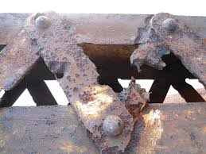

Figures showing Consequences of Pitting

Slide 59
Failure Analysis
Purpose of failure analysis is to determine the most fundamental reason which caused the failure (i.e., root cause), ideally with the intention of eliminating it and identifying means to prevent its recurrences.
The basic steps of the failure analysis procedure include the following:
Definition of the problem and data collection.
Identification of damage modes and mechanisms.
Testing for the actual mechanisms taking place, leading to the failure.
Identification of the possible root causes.
Confirmation of cause-effect relationships.
Tests of the actual root cause.
The implementation of corrective actions.

Slide 60
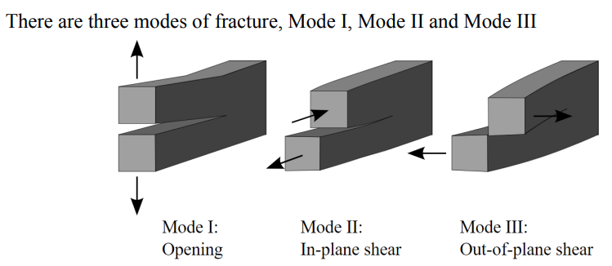
Modes of fracture

Slide 61


Slide 62


Types of Loadings
Static: When the load is increased slowly and gradually and the metal is loaded by tension, compression, and torsion or bending.
Dynamic: When the load increases rapidly as in impact
Repeated or Fatigue: (both static and impact type) . i.e. when the load repeatedly varies in the course of test either in value or both in value and direction

Slide 63
‘Stress Raisers’ and ‘Residual Stress’ as Strength Reducers
Stress-raisers are sharp corners, grooves, notches or acute changes of section that cause stress concentrations under normal loadings. They can be found on both rotating and static components.
Residual stresses are those stresses that remain in an object (in particular, in a welded component) even in the absence of external loading or thermal gradients. In some cases, residual stresses result in significant plastic deformation, leading to warping and distortion of an object. In others, they affect susceptibility to fracture and fatigue.

